Slide 1
Carousel,Gallary

Slide 2
1.Carousel

Slide 3
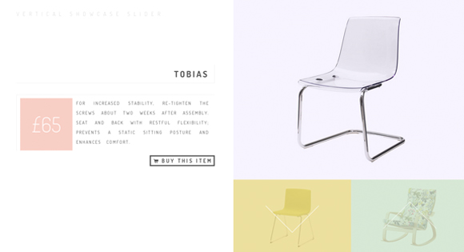
http://tympanus.net/codrops/2012/10/01/vertical-showcase-slider-with-jquery-and-css-transitions/

Slide 4

http://tympanus.net/codrops/2012/09/19/fullscreen-video-slideshow-with-bigvideo-js/

Slide 5

http://tympanus.net/codrops/2012/08/16/triple-panel-image-slider/

Slide 6
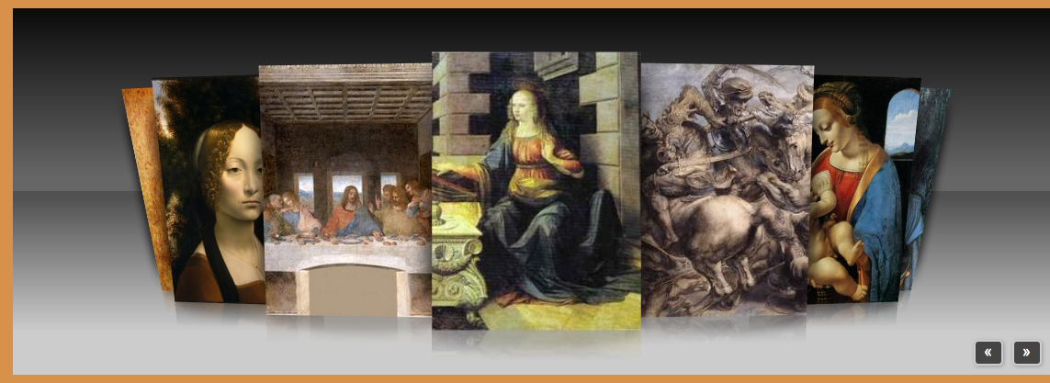
http://www.starplugins.com/killercarousel

Slide 7

http://tympanus.net/codrops/2012/08/01/photo-booth-strips-with-lightbox/

Slide 8

http://tympanus.net/codrops/2012/06/06/image-accordion-with-css3/

Slide 9

http://tympanus.net/codrops/2012/06/05/fullscreen-slit-slider-with-jquery-and-css3/

Slide 10

http://tympanus.net/codrops/2011/08/16/circular-content-carousel/

Slide 11
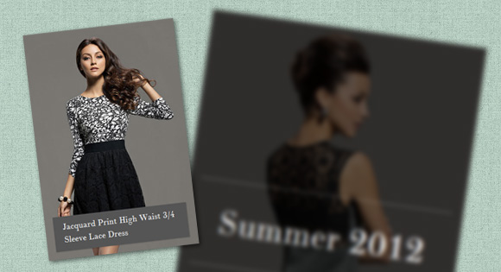
http://tympanus.net/codrops/2012/05/09/how-to-create-a-fast-hover-slideshow-with-css3/

Slide 12

http://tutorialzine.com/2011/07/bubble-slideshow-jquery-css/

Slide 13

http://tympanus.net/codrops/2012/04/30/fluid-css3-slideshow-with-parallax-effect/

Slide 14
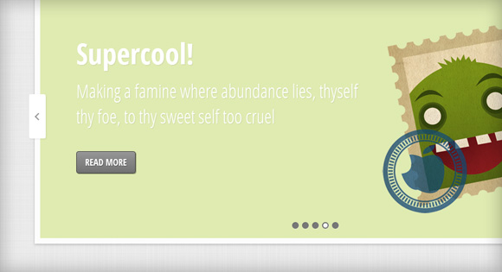
http://tympanus.net/codrops/2012/04/05/slideshow-with-jmpress-js/

Slide 15

http://tympanus.net/codrops/2012/01/17/sliding-image-panels-with-css3/

Slide 16

http://tympanus.net/codrops/2012/01/02/fullscreen-background-image-slideshow-with-css3/

Slide 17

http://tympanus.net/codrops/2011/08/09/portfolio-image-navigation/

Slide 18

http://tympanus.net/codrops/2011/11/21/elastic-image-slideshow-with-thumbnail-preview/

Slide 19
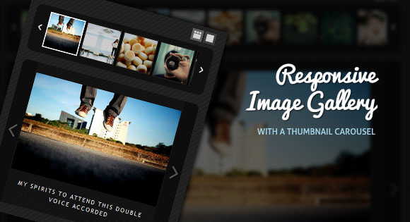
http://tympanus.net/codrops/2011/09/20/responsive-image-gallery/

Slide 20

http://tympanus.net/codrops/2011/07/05/fullscreen-slideshow-with-html5-audio/

Slide 21
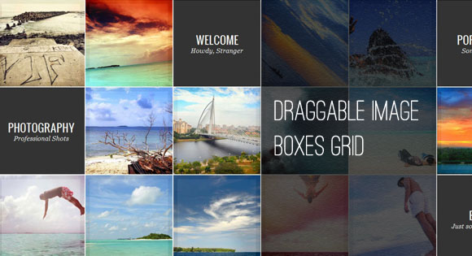
http://tympanus.net/codrops/2011/10/07/draggable-image-boxes-grid/

Slide 22
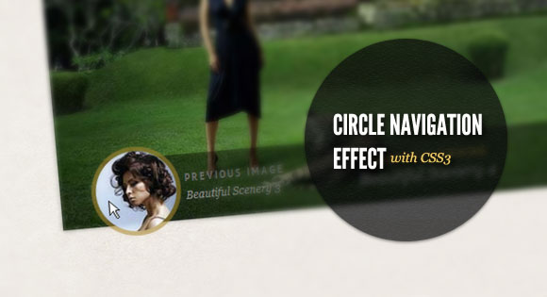
http://tympanus.net/codrops/2011/10/10/circle-navigation-effect-with-css3/

Slide 23

http://tympanus.net/codrops/2011/04/28/rotating-image-slider/

Slide 24
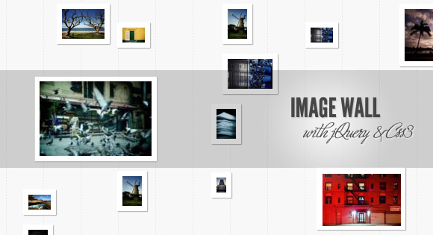
http://tympanus.net/codrops/2011/05/25/image-wall/

Slide 25

http://tympanus.net/codrops/2011/01/19/sweet-thumbnails-gallery/

Slide 26
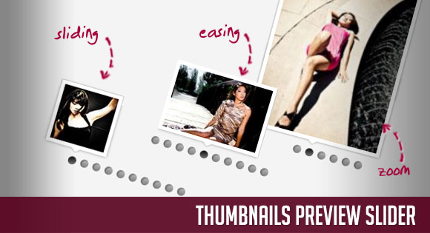
http://tympanus.net/codrops/2011/01/27/thumbnails-preview-slider/

Slide 27
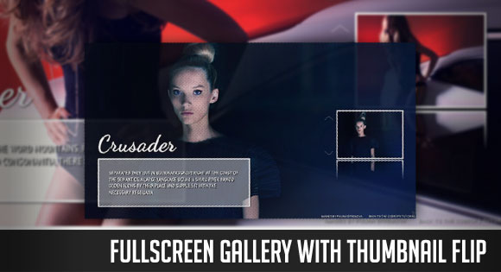
http://tympanus.net/codrops/2011/02/09/fullscreen-gallery-with-thumbnail-flip/

Slide 28

http://tympanus.net/codrops/2011/01/03/parallax-slider/

Slide 29

http://tympanus.net/codrops/2010/12/10/bubbleriffic-image-gallery/

Slide 30

http://tympanus.net/codrops/2010/11/16/hover-slide-effect/

Slide 31

http://tympanus.net/codrops/2010/11/14/animated-portfolio-gallery/

Slide 32

http://tympanus.net/codrops/2010/09/08/full-page-image-gallery/

Slide 33
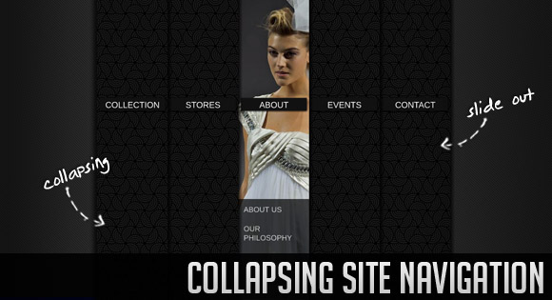
http://tympanus.net/codrops/2010/09/06/collapsing-site-navigation/

Slide 34

http://tympanus.net/codrops/2010/10/07/slider-gallery/

Slide 35

http://tympanus.net/codrops/2010/09/28/polaroid-photobar-gallery/

Slide 36

http://tympanus.net/codrops/2010/07/29/thumbnails-navigation-gallery/

Slide 37

http://tympanus.net/codrops/2010/06/27/beautiful-photo-stack-gallery-with-jquery-and-css3/

Slide 38

http://tympanus.net/codrops/2010/12/27/portfolio-zoom-slider/

Slide 39

http://tympanus.net/codrops/2010/06/10/flickr-photobar-gallery/

Slide 40

http://tympanus.net/codrops/2010/05/27/awesome-mobile-image-gallery-web-app/

Slide 41

http://tympanus.net/codrops/2010/05/23/fresh-sliding-thumbnails-gallery-with-jquery-php/

Slide 42
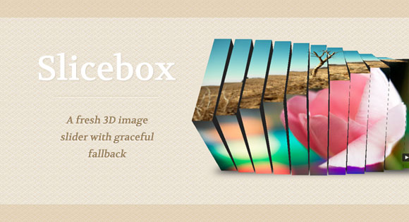
http://tympanus.net/codrops/2011/09/05/slicebox-3d-image-slider/

Slide 43
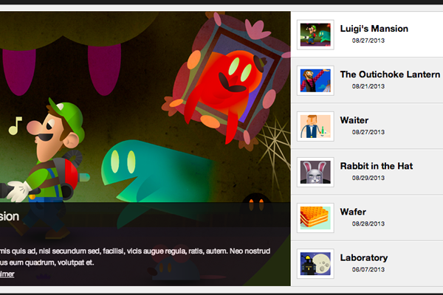
http://designm.ag/tutorials/image-rotator-css-jquery/

Slide 44

http://www.zhinengshe.com/works/3521/zns_demo.html

Slide 45

http://tympanus.net/codrops/2010/05/14/sliding-panel-photo-wall-gallery-with-jquery/

Slide 46
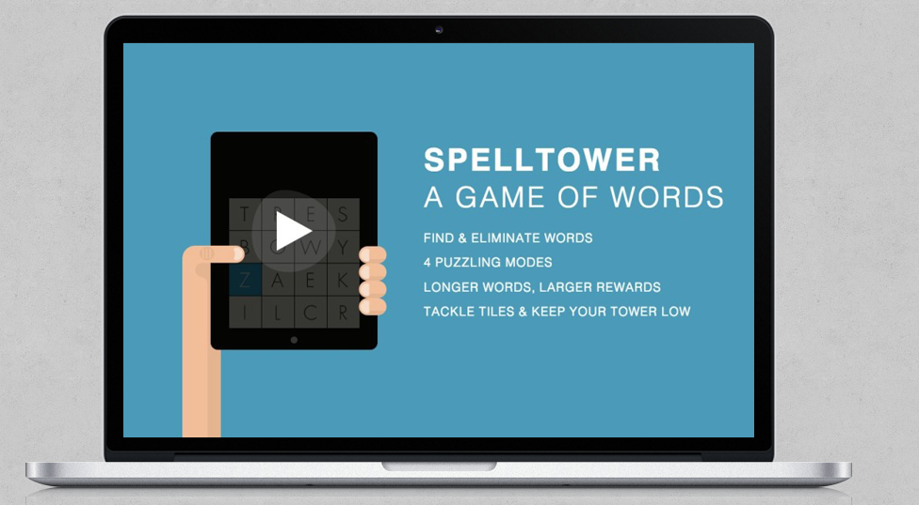
http://bassta.bg/2013/05/simple-fade-infade-out-slideshow-with-tweenlite/

Slide 47
http://tympanus.net/codrops/2011/10/10/circle-navigation-effect-with-css3/

Slide 48
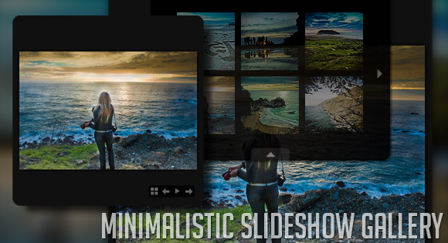
http://tympanus.net/codrops/2010/07/05/minimalistic-slideshow-gallery/

Slide 49
照片堆

Slide 50
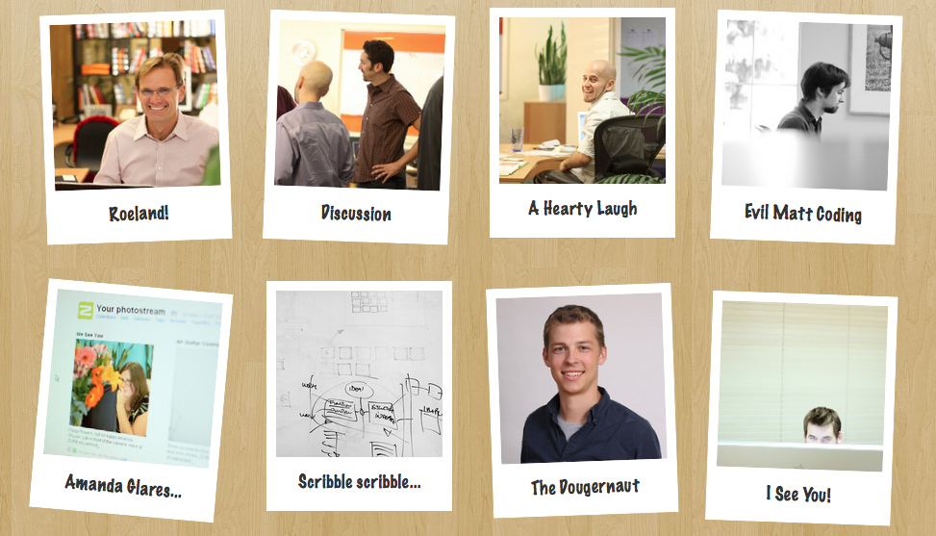
http://zurb.com/playground/css3-polaroids

Slide 51

http://www.3site.eu/examples/gallery/

Slide 52
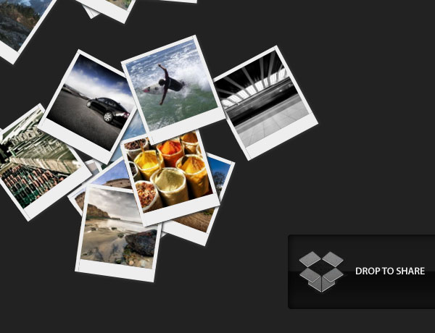
http://tutorialzine.com/2009/11/hovering-gallery-css3-jquery/

Slide 53

http://media.24ways.org/2009/14/5/index.html

Slide 54
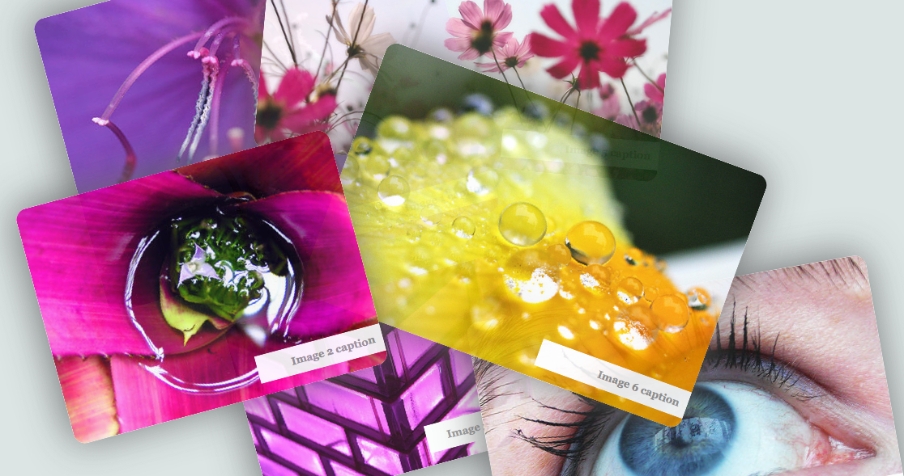
http://www.alexandtheweb.com/demos/transitions-test.html

Slide 55
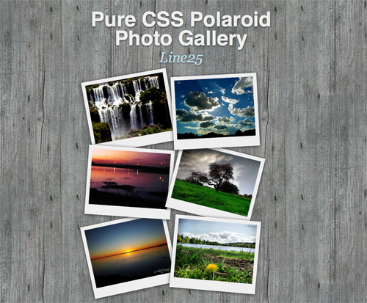
http://line25.com/tutorials/how-to-create-a-pure-css-polaroid-photo-gallery

Slide 56
http://tympanus.net/codrops/2011/08/09/portfolio-image-navigation/

Slide 57
http://tympanus.net/codrops/2011/08/09/portfolio-image-navigation/

Slide 58
http://tympanus.net/codrops/2011/08/09/portfolio-image-navigation/

Slide 59
http://tympanus.net/codrops/2011/08/09/portfolio-image-navigation/

Slide 60
http://tympanus.net/codrops/2011/08/09/portfolio-image-navigation/

